Slide 1
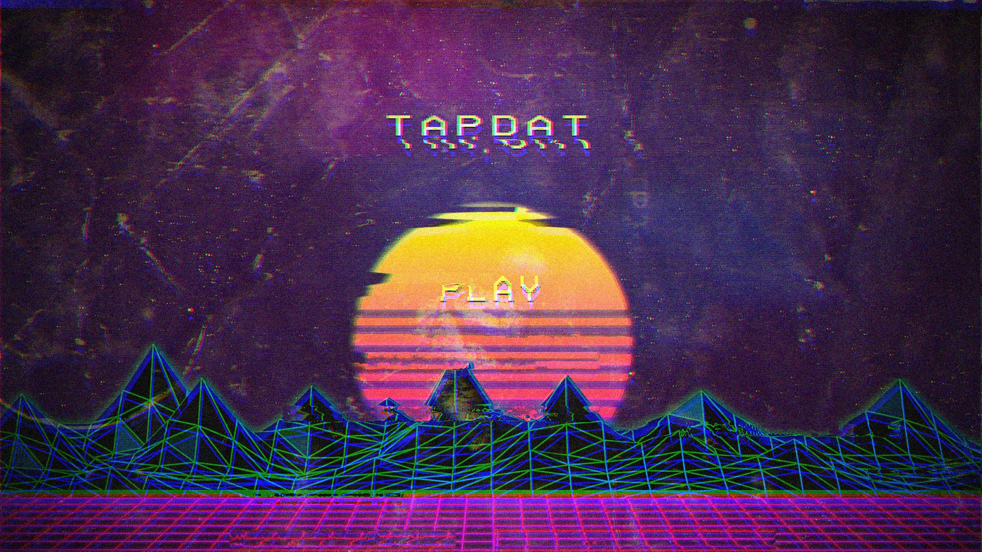

Slide 2
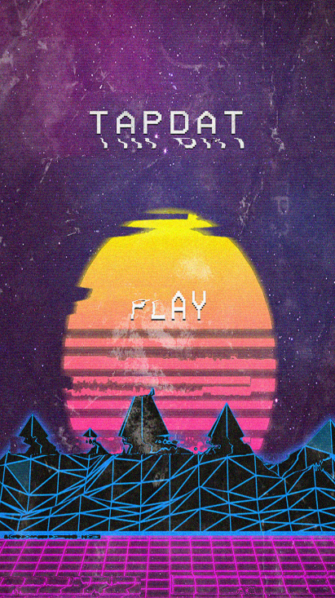
Start screen, fades in, then player taps the PLAY button

Slide 3
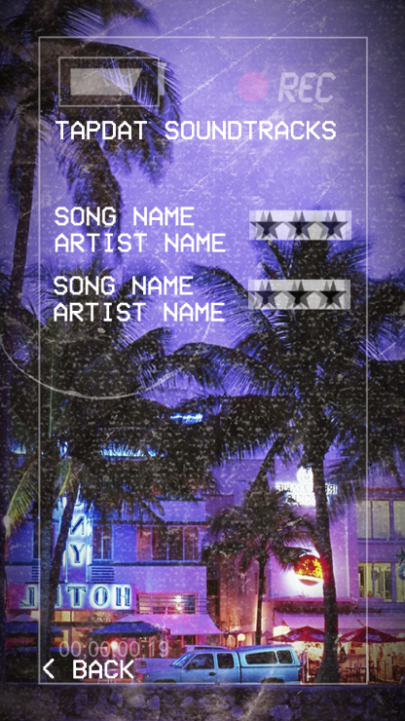
Various songs listed, loaded from a file at the moment
Takes the player back to the start screen

Slide 4
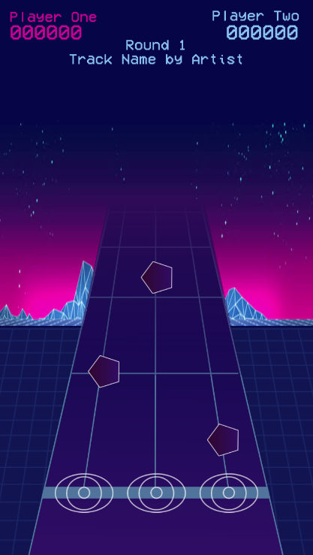
Player name turns pink to indicate the current player
Multiple rounds, each player takes it in turn
Notes appear on screen for duration of song, for
the prototype the notes are randomly genreated.
Tapping on an “eye” when the note is within it means
the player score increases

